Slide 1
Section 3.4 Slopes of Parallel and Perpendicular Lines
© Copyright all rights reserved to Homework depot: www.BCMath.ca

Slide 2
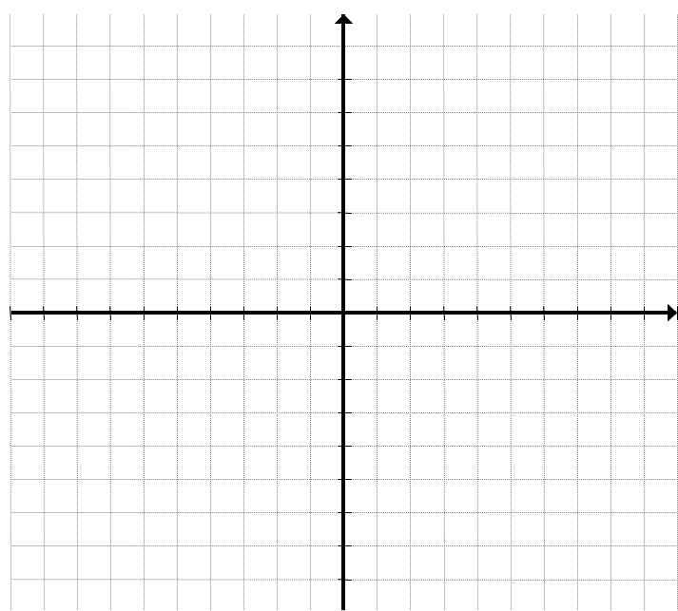
I) Parallel and Perpendicular Lines
Parallel Lines have equal slopes
Perpendicular lines cross at 90 degrees
The slopes are negative reciprocals
A
(-2,8)
C
(-6,2)
B
(5,-1)
D
(-2,-7)

Slide 3
Ex: Given the following points, indicate whether if the lines are parallel
A (-6,8)
B(4,8)
B (6,4)
C
(-8,-1)
A(-8,0)
D(5,-2)
D(10,-7)
C (-3,-8)
AB and CD are parallel
AB and CD are not parallel

Slide 4
Ex: Given that lines EF and GH are parallel, and that point “H” is on the Y-axis. Find the coordinates of point “H”.
First find the slope of EF
F
(2,8)
Since the lines are parallel, they have the same slope
E
(-8,4)
Plug the coordinates of “H’ & “G” into the slope formula:
H
(0,?)
G
(-4,-5)
Therefore, the coordinates of “H” are (0,-3.4)

Slide 5
Ex: Given the 3 points of parallelogram ABCD, with points A(3,1), B(-5, -6), C(-3,1), find the coordinates of point “D”:
Plot the points
D
(5,8)
Measure the slope of one side
C
(-3,1)
A
(3,1)
Apply the slope to find the opposite side
B
(-5,-6)

Slide 6
II) Properties of Perpendicular Lines
When two slopes are perpendicular, the slopes will “negative reciprocals
Flip the number and change the sign!
Ex: Find the negative reciprocal of each number:
If you multiply two numbers that are negative reciprocals, the product will be negative one
Note: If two slopes are perpendicular, their product will be negative one

Slide 7
Ex: Given the points, check if the two lines are perpendicular
A
(-7,8)
Find the slope of both lines:
D
(3,6)
B
(-2,5)
Multiply the slopes of AB & CD.
If the product is -1, then the lines are perpendicular
C
(-3,-4)
The lines are perpendicular!

Slide 8
Ex: Given the points, check if the two lines are perpendicular
Find the slope of both lines:
B
(-5,4)
C
(-1,2)
Multiply the slopes of AB & CD.
If the product is -1, then the lines are perpendicular
A
(-10,-3)
D
(4,-5)
The lines are NOT perpendicular!

Slide 9
Ex: Given the vertices of Δ ABC, check if it is a right triangle?
IF Δ ABC is a right triangle, then two sides must be perpendicular
B
(-2,5)
Find the slope of all sides:
A
(-6,-2)
Δ ABC is a Right Triangle!
C
(1,-6)
Check if any slopes are “Negative Reciprocal”

Slide 10
Challenge: Given that the following three points are on a line, find the equation of the line: A(e,f), B(f,e), and C(0,6)

Slide 11
Challenge: Δ ABC is an Isosceles Right Triangle. The Hypotenuse AB is on the X-axis. Find the coordinates of “C”
C
(-1,5)
C
(?,?)
C
(?,?)
Point “C” is unknown, and it makes an Isosceles Right Triangle
Since it’s an isosceles triangle, opposite sides must be equal.
The product of the two slopes is -1 (Perpendicular)
A
(-6,0)
B
(4,0)
Point “C” must be in the middle between “A” & “B”
Solve for “x”
Since it’s also a Right triangle, the two sides must be perpendicular.
Slope of AC & CB must be negative reciprocal
The coordinates of “C” is (-1,5)

Slide 12
Challenge Problem: Given that point “A” is on the X-Axis, “B” is on the Y-Axis, the length of AB is 10 units, and slope is 4/3. Find the coordinates of both points:
The hypotenuse is too small. So we need to make a bigger right triangle with an hypotenuse of 10
B
(0, 8)
Analyzer the information
“A” is on the X-axis
B
(0, ?)
5
10
“B” is on the Y-axis
A
( -6,0)
A
( ?,0)
5
A
(6,0)
The slope is:
The coordinates are A(-6,0) & B(0,8)
Right triangle, with the base 3, height 4, and the hypotenuse is 5.
B
(0, -8)
The Length of AB is 10 units
Another set of coordinates are A(6,0) & B(0,-8)
10

Slide 13
Q2: Given the rectangle, how many squares does the diagonal cross?

